Slide 1
Maruti Case Assignment

Slide 2
Instructions
Questions posed in the case:
  With such a dismal outlook for the automobile industry and with poor price maneuverability, how long could Maruti sustain profits?
  The chairman had to decrease the costs of manufacturing and he was considering building a state-of-the-art plant in Gujarat. Would this reduce costs enough to help Maruti become more profitable?
  Could R.C. Bhargava find a way to increase prices to achieve higher profitability, thus avoiding the capital expenditure of building a plant? Would the building of a new plant really sustain profits, or would it take so long that it would not be worth the initial investment?
Your assignment:
  Use the tools we’ve learned in this class to analyze the economic environment facing Maruti and make recommendations on what strategic choices Chairman Bhargava should take to turn profits around – to stop them from downturn, to sustain current levels and to improve long term profit potential. During this, you would likely answer the questions “posed in the case” (above).
  REMEMBER: This is ECONOMICS. You are to come from an ECONOMICS perspective, not any other, and really not from your wheelhouse / expertise. So, engineers – don’t give me engineering analysis. Accountants – I don’t want accounting. Market & HR – I don’t want marketing & HR solutions. Etc.
Due date & deliverable:
  August 1 (by 9:59 PM Eastern time): Submit your case analysis and recommendations. Use the CERC framework to create and defend your arguments. CERC stands for Claim, Evidence, Reasoning and Conclusion. The ECONOMICS will likely be heaviest in the Reasoning portion as you are using ECONOMIC theory to connect Evidence to your Claim and support your claim.
  Comment on length: The way I look at it is, I’m your boss. Make it long enough to give me the information I’m looking for, but not so long that you lose my attention. Get your point across well and tersely. I would think that a WELL WRITTEN submission will be a terse tightly argued 5 pages or so. This estimate DOES NOT COUNT cover page and diagrams. With those, it would be around 7 pages, right?

Slide 3
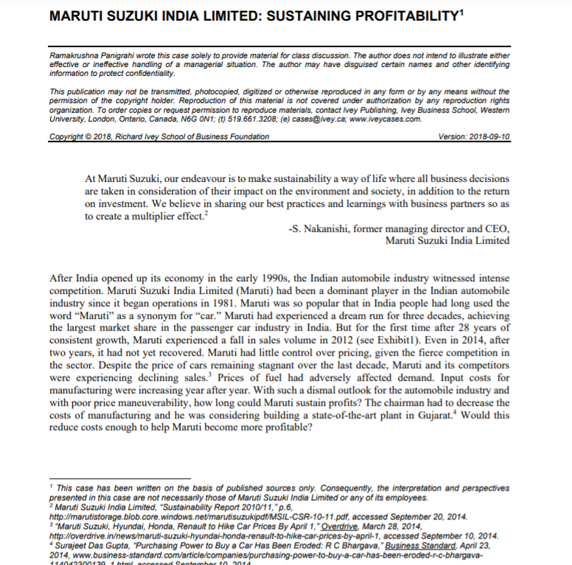

Slide 4
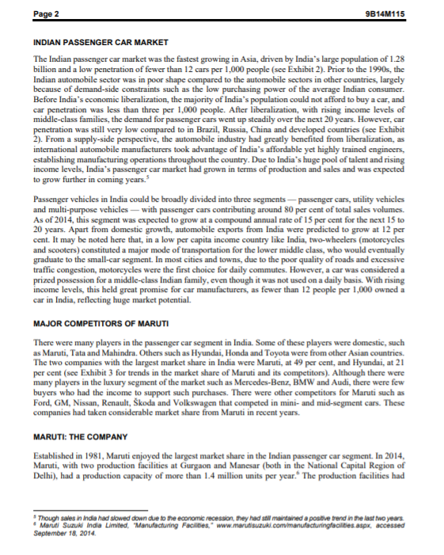

Slide 5
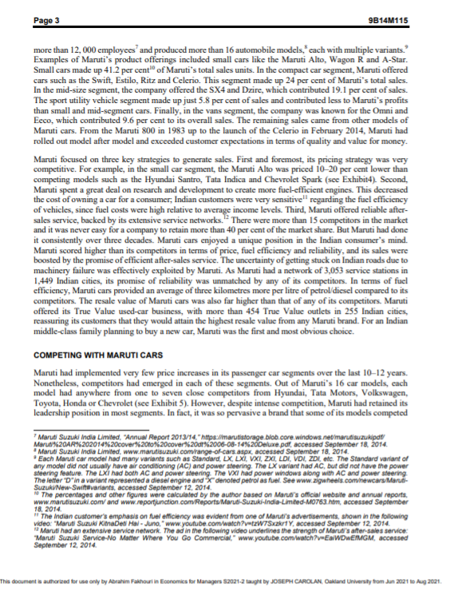

Slide 6
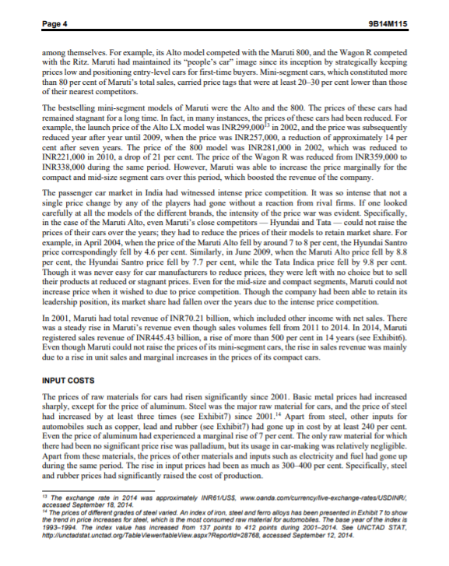

Slide 7
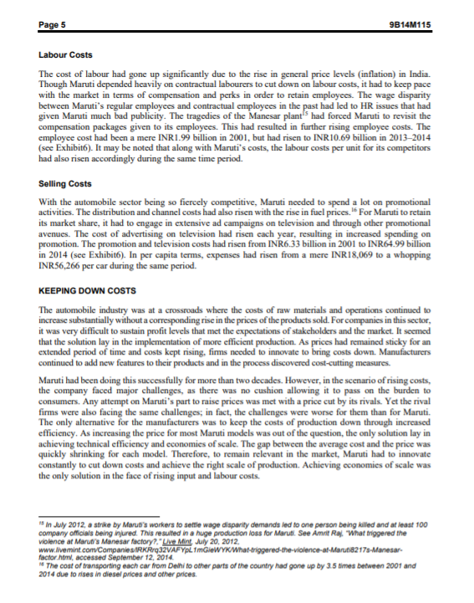

Slide 8
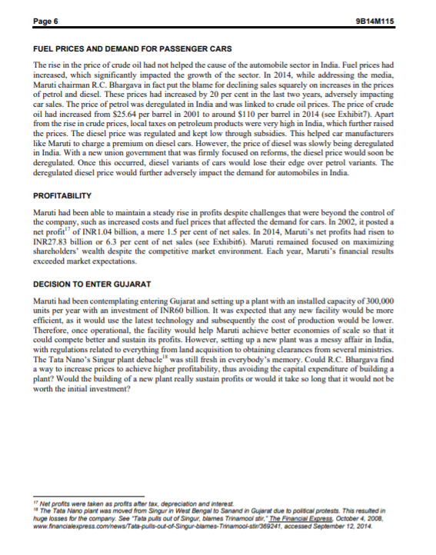

Slide 9
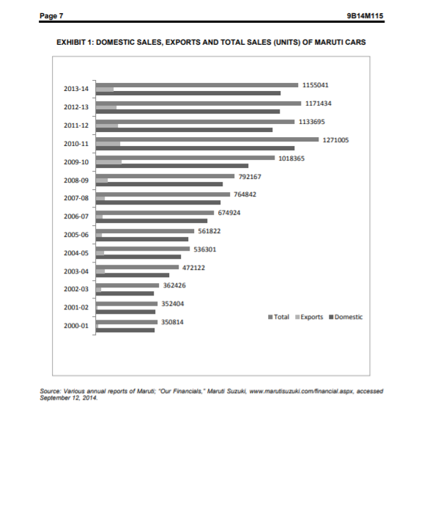

Slide 10
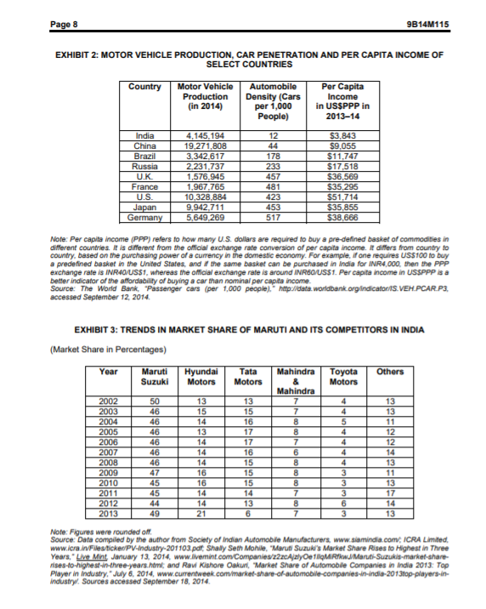

Slide 11
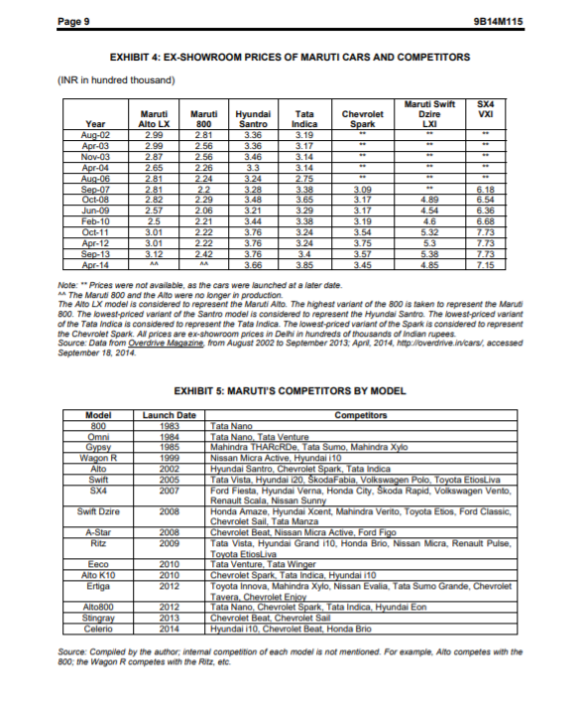

Slide 12
